Slide 1
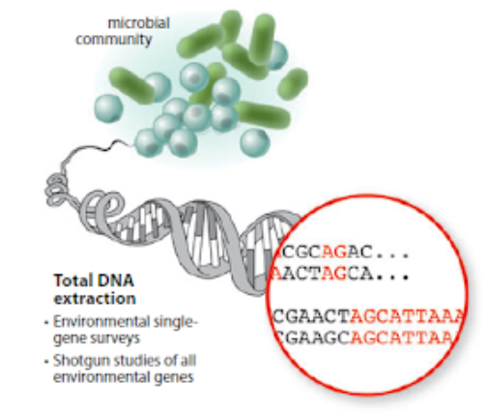

Integration
Transcriptomics
Data to GEMs
http://hulab.ucf.edu/research/projects/metagenomics/introduction.html
ÖZLEM ALTAY, MD, PhD
Notes:
https://envgen.github.io/metagenomics.html
http://hulab.ucf.edu/research/projects/metagenomics/introduction.html

Slide 2
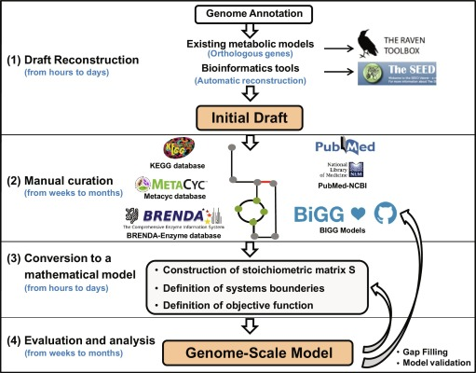
Gudmundsson S, Agudo L, Jogales J. Microalgae-Based Biofuels and Bioproducts. 2017, Pages 93-111

Slide 3
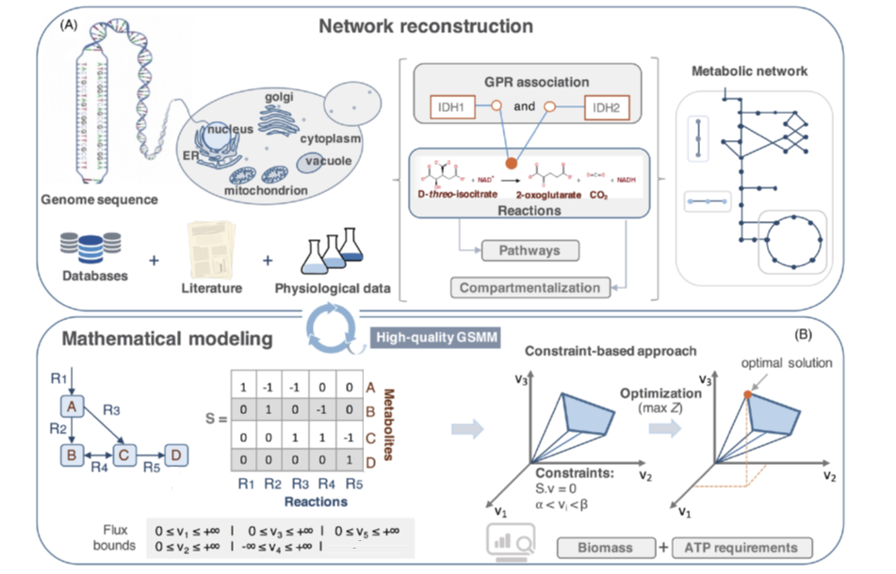
Figure 1. Metabolic network reconstruction and mathematical modeling of genome-scale networks. (A) A draft metabolic network can be generated using genomic,
biochemical and physiological information available in primary literature or proper databases. All annotated metabolic genes are first matched to enzymes and then
to the reactions—composed by different metabolites and cofactors—to obtain GPR associations. Reactions are assembled into pathways which together constitute
the metabolite network. Localization has also to be considered since chemically identical metabolites may be present in different cellular compartments. (B) The
reconstructed genome-scale metabolic network is then transformed into a constraint-based model, by first converting it to a mathematical representation using a
stoichiometric matrix (S) of the metabolite coefficients in each reaction, and further assuming pseudo-steady state and constraining the reaction flux (v) bounds. The
system of linear equations defines the admissible flux space of solutions (known as flux cone) and using an objective function defining an optimization problem it is
possible to find optimal solutions for a desired output. To simulate model growth and obtain meaningful flux distributions, information on biomass composition and
ATP requirements of the cellmust also be available. The generation of high-end genome-scalemetabolic models often requires several cycles of testing and refinement
based on the comparative results of in silico simulations and experimental data.
Modified from https://www.ncbi.nlm.nih.gov/pmc/articles/PMC5812505/

Slide 4
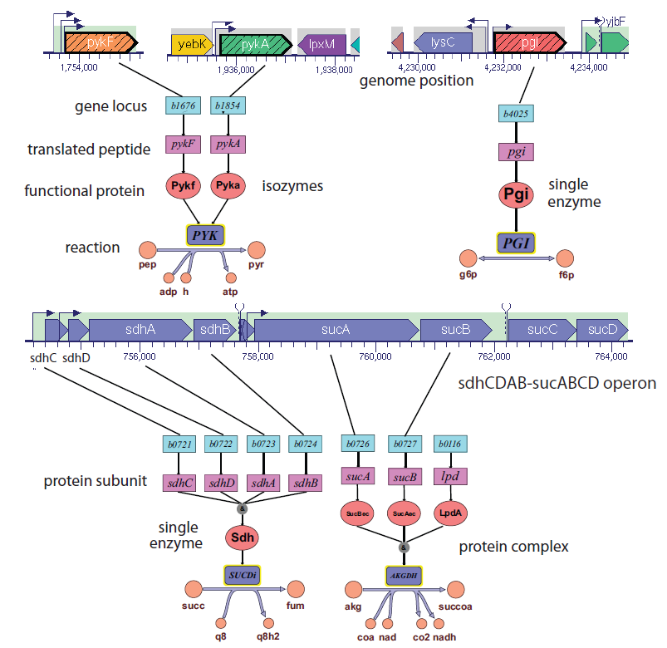
Reaction and metabolite information
Reaction Name *
Reaction Definition *
Reaction Formula *
Gene Reaction Relationship *
Genes (Gene Loci) *
Proteins
Cellular Subsystem * (eg Glycolysis)
Direction of Reaction *
Flux Lower Limit *
Flux Upper Limit *
Confidence Score (1-5)
EC Number
Notes
References
Metabolite Name *
Metabolite Definition *
Metabolite Neutral Formula
Metabolite Loaded Formula *
Metabolite Load *
Metabolite Compartment *
Metabolite KEGG ID
Metabolite PubChemID
* Essential
Reconstruction and Use of Microbial Metabolic Networks: the Core Escherichia coli Metabolic Model as an Educational Guide by Orth, Fleming, and Palsson (2010)

Slide 5
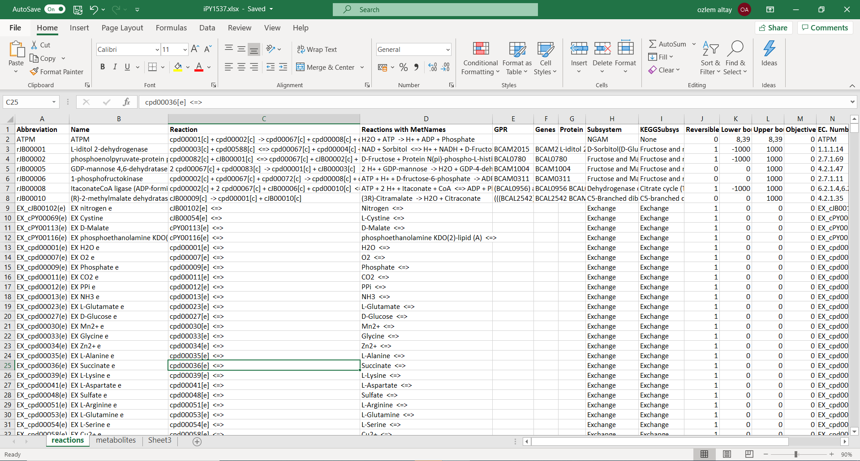
https://bme.virginia.edu/csbl/Downloads1-burkholderia-cepacia.html

Slide 6
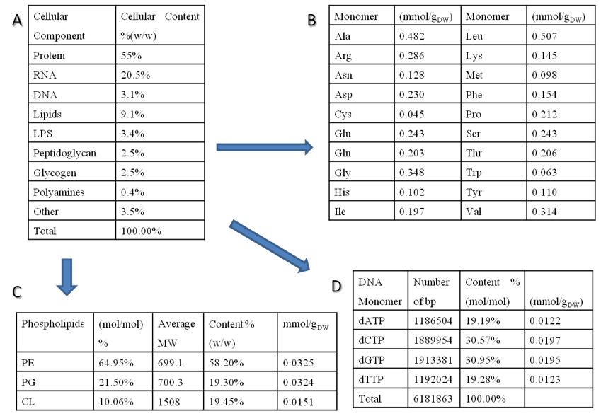
Biomass Composition Determination for Pseudomonas putida KT 2440
Chemical composition of E. coli adopted from11 and utilized as a template for P. putida KT2440, since no extensive information was available.
Protein composition in P. putida broken down by monomer contributions in mmol/gDW.
dNTP composition of the entire P. putida chromosomal genome. The data are obtained from direct measurements, literature, or can be estimated from genome information.
Phospholipid contributions to the biomass function where PE is phosphatidylethanolamine, PG is phosphatidylglycerol, and CL is cardiolipin.
Thiele, I. and B. O. Palsson (2010). "A protocol for generating a high-quality genome-scale metabolic reconstruction." Nature protocols 5(1): 93-121, Supplementary Methods.
Notes:
Figure S3: Example of biomass composition determination for Pseudomonas putida KT 2440. A. Chemical composition of E. coli adopted from11 and utilized as a template for P. putida KT2440, since no extensive information was available. B. Protein composition in P. putida broken down by monomer contributions in mmol/gDW. C. Phospholipid contributions to the biomass function where PE is phosphatidylethanolamine, PG is phosphatidylglycerol, and CL is cardiolipin. D. dNTP composition of the entire P. putida chromosomal genome. The data are obtained from direct measurements, literature, or can be estimated from genome information

Slide 7
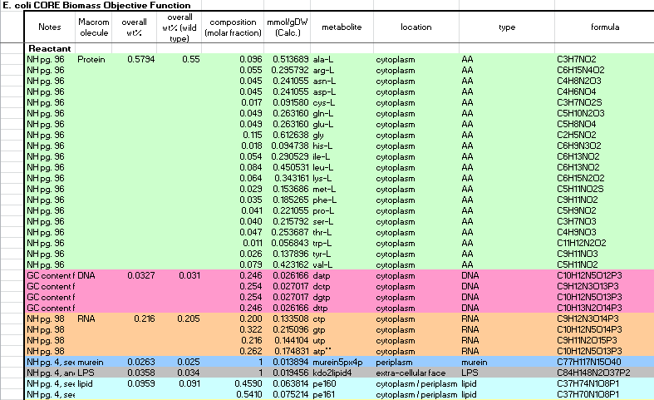
Ecoli_iaf1260 Core Biomass Objective Function Spreadsheet
Feist, A. M., C. S. Henry, et al. (2007). "A genome-scale metabolic reconstruction for Escherichia coli K-12 MG1655 that accounts for 1260 ORFs and thermodynamic information." Molecular Systems Biology 3: 121, Supplementary Information 3.

Slide 8

Integration transcriptomic data
to metabolic model

Slide 9
METAGENOMICS
http://hulab.ucf.edu/research/projects/metagenomics/introduction.html
ÖZLEM ALTAY, MD, PhD
Notes:
https://envgen.github.io/metagenomics.html
http://hulab.ucf.edu/research/projects/metagenomics/introduction.html

Slide 10
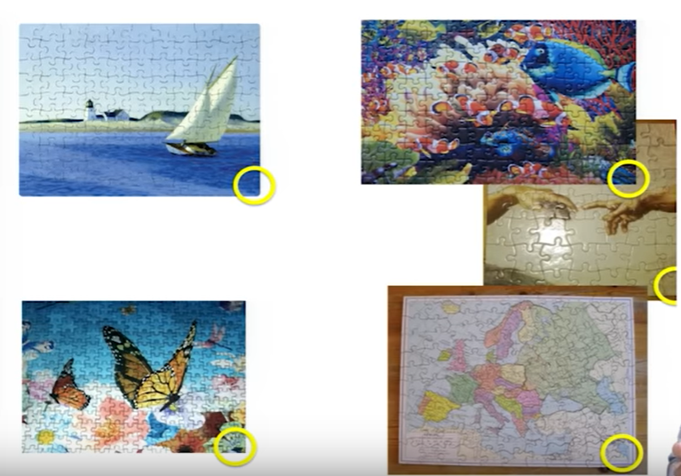
16S rRNA gene sequencing
Screenshot image from video tutorial Dan Knight Microbiome Discovery 2: How microbiome data are generated. https://www.youtube.com/watch?v=FWT1HBzlWOE

Slide 11
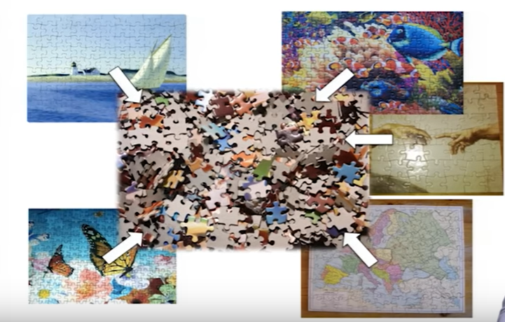
Shotgun Sequencing
Screenshot image from video tutorial Dan Knight Microbiome Discovery 2: How microbiome data are generated. https://www.youtube.com/watch?v=FWT1HBzlWOE

Slide 12
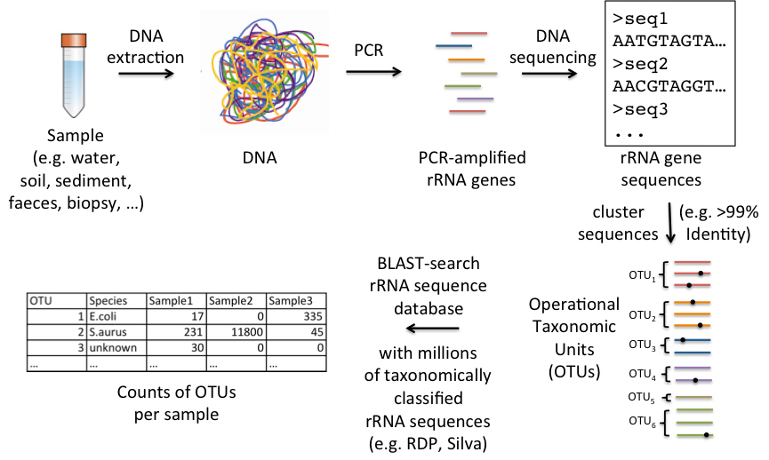
16S rRNA gene sequencing
https://envgen.github.io/metagenomics.html

Slide 13
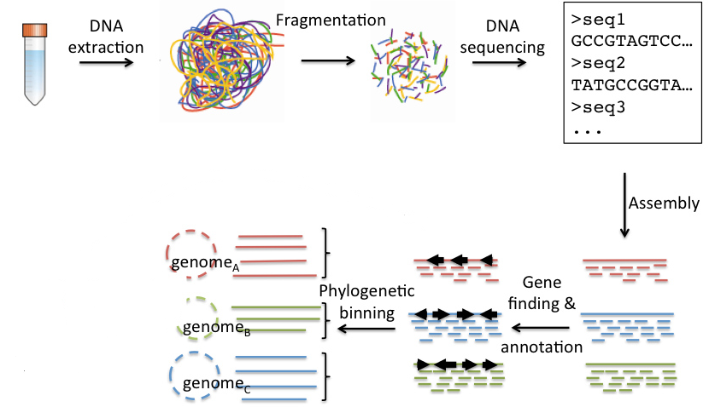
Shotgun Sequencing
https://envgen.github.io/metagenomics.html

Slide 14
16S rRNA gene sequencing
• Pros
– Well established
– Sequencing costs are relatively cheap (~50,000 reads/sample)
– Only amplifies what you want (no host contamination)
• Cons
– Primer choice can bias results towards certain organisms
– Usually not enough resolution to identify to the strain level
– Need different primers usually for archaea & eukaryotes (18S)
– Cannot identify viruses
– No direct functional profiling
https://envgen.github.io/metagenomics.html

Slide 15
Shotgun metagenomics
• Pros
– No primer bias
– Can identify all microbes (e.g. eukaryotes, viruses)
– Direct functional profiling
• Cons
– More expensive
– Host/site contamination can be significant
– May not be able to sequence “rare” microbes
– Required computational resources
– More complex bioinformatic analyses required
https://envgen.github.io/metagenomics.html

Slide 16
Compositional profiling

Slide 17
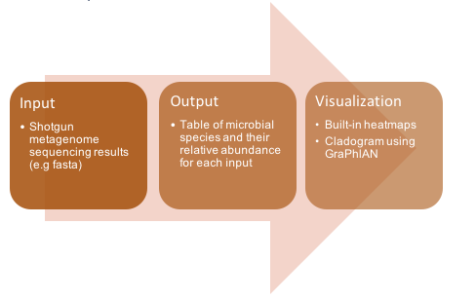
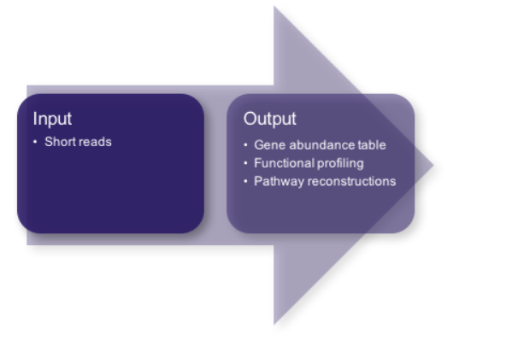
Compositional profiling
MetaPhlAn2: Metagenomic Phylogenetic Analysis 2
Nicola Segata, Levi Waldron, Annalisa Ballarini, Vagheesh Narasimhan, Olivier Jousson, Curtis Huttenhower. Metagenomic microbial community profiling using unique clade-specific marker genes. Nature Methods, 8, 811–814, 2012

Slide 18
MetaPhlAn2 Features
Relies on ~1M unique clade-specific marker genes identified from ~17,000 reference genomes
(~13,500 bacterial and archaeal, ~3,500 viral, and ~110 eukaryotic)
unambiguous taxonomic assignments;
accurate estimation of organismal relative abundance;
species-level resolution for bacteria, archaea, eukaryotes and viruses;
strain identification and tracking
orders of magnitude speedups compared to existing methods.
Nicola Segata, Levi Waldron, Annalisa Ballarini, Vagheesh Narasimhan, Olivier Jousson, Curtis Huttenhower. Metagenomic microbial community profiling using unique clade-specific marker genes. Nature Methods, 8, 811–814, 2012

Slide 19
MetaPhlAn2 Setup
Requirements
•Python (version >= 2.7)
•Bowtie2
•Numpy
•Pandas (optional, only required by utility scripts)
•BioPython (optional, only required by utility scripts)
•SciPy (optional, only required by utility scripts)
•Matplotlib (optional, only required by utility scripts)
•biom (optional, only required for biom format input/output)
pip, Conda, or Docker
For details, please refer to the MetaPhlAn2 User Manual
Nicola Segata, Levi Waldron, Annalisa Ballarini, Vagheesh Narasimhan, Olivier Jousson, Curtis Huttenhower. Metagenomic microbial community profiling using unique clade-specific marker genes. Nature Methods, 8, 811–814, 2012

Slide 20
MetaPhlAn2 Input
Metagenomic sequence in several formats
.fasta, .fastq, and .tar.bz2.
•filtered_wrkshpF.fastq
•filtered_wrkshpR.fastq
Nicola Segata, Levi Waldron, Annalisa Ballarini, Vagheesh Narasimhan, Olivier Jousson, Curtis Huttenhower. Metagenomic microbial community profiling using unique clade-specific marker genes. Nature Methods, 8, 811–814, 2012

Slide 21
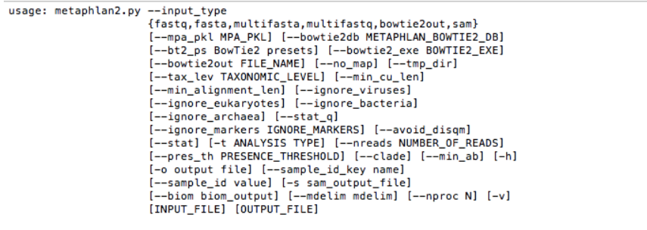
MetaPhlAn2 Run
cd /path/to/file/
metaphlan2.py /path/to/file/filtered_wrkshpF.fastq --input_type fastq --nproc 16 > /path/to/file/metaphlan2_filtered_wrkshpF.txt
Nicola Segata, Levi Waldron, Annalisa Ballarini, Vagheesh Narasimhan, Olivier Jousson, Curtis Huttenhower. Metagenomic microbial community profiling using unique clade-specific marker genes. Nature Methods, 8, 811–814, 2012

Slide 22
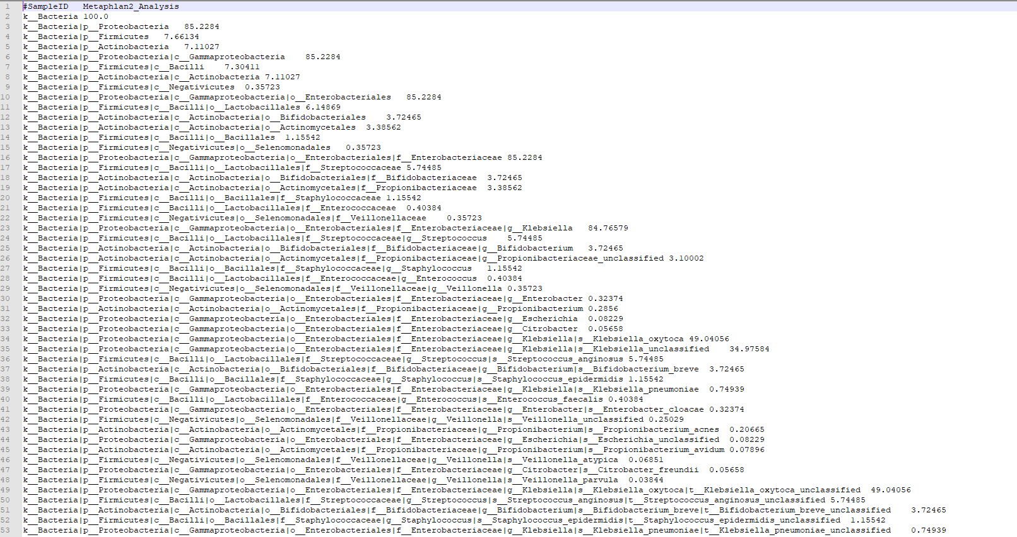
MetaPhlAn2 Output One sample
Nicola Segata, Levi Waldron, Annalisa Ballarini, Vagheesh Narasimhan, Olivier Jousson, Curtis Huttenhower. Metagenomic microbial community profiling using unique clade-specific marker genes. Nature Methods, 8, 811–814, 2012

Slide 23
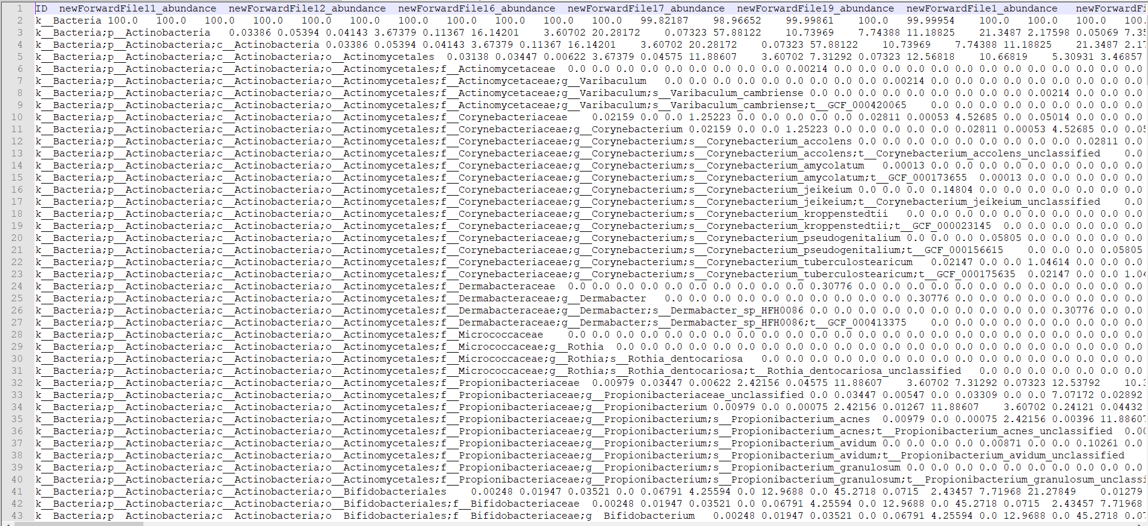
MetaPhlAn2 Output Multiple samples
merge_metaphlan_tables.py *_profile.txt > merged_abundance_table.txt

Slide 24
Diversity Analysis

Slide 25
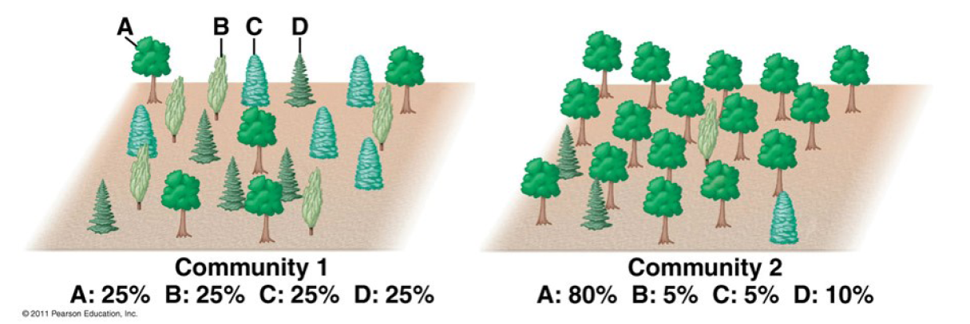
.
https://rpubs.com/dillmcfarlan/R_microbiotaSOP
Alpha diversity (microbial community evenness and richness)
Beta diversity similarity between individual microbial communities
How many different species (OTUs) are in each sample(richness)
How evenly they are distributed (evenness)
This image illustrates richness vs diversity. Both forests have the same richness (4 tree species) but Community 1 has much more even distribution of the 4 species while Community 2 is dominated by tree species A. This makes Community 1 more diverse than Community 2.

Slide 26
Functional profiling

Slide 27
Functional profiling
Profiling the presence/absence and abundance of microbial pathways
HUMAnN2: The HMP Unified Metabolic Analysis Network 2
Franzosa EA*, McIver LJ*, Rahnavard G, Thompson LR, Schirmer M, Weingart G, Schwarzberg Lipson K, Knight R, Caporaso JG, Segata N, Huttenhower C. Species-level functional profiling of metagenomes and metatranscriptomes. Nat Methods 15: 962-968 (2018).

Slide 28
HUMAnN2 Features
Community functional profiles stratified by known and unclassified organisms
MetaPhlAn2 and ChocoPhlAn pangenome database : fast, accurate, and organism-specific profiling
Organisms included: Archaea, Bacteria, Eukaryotes, and Viruses
Considerably expanded databases of genomes, genes, and pathways
UniRef database provides gene family definitions
MetaCyc provides pathway definitions by gene family
MinPath is run to identify the set of minimum pathways
A simple user interface (single command driven flow)
Provide a quality-controlled metagenome or metatranscriptome
Accelerated mapping of reads to reference databases
Bowtie2 is run for accelerated nucleotide-level searches
Diamond is run for accelerated translated searches
Franzosa EA*, McIver LJ*, Rahnavard G, Thompson LR, Schirmer M, Weingart G, Schwarzberg Lipson K, Knight R, Caporaso JG, Segata N, Huttenhower C. Species-level functional profiling of metagenomes and metatranscriptomes. Nat Methods 15: 962-968 (2018).

Slide 29
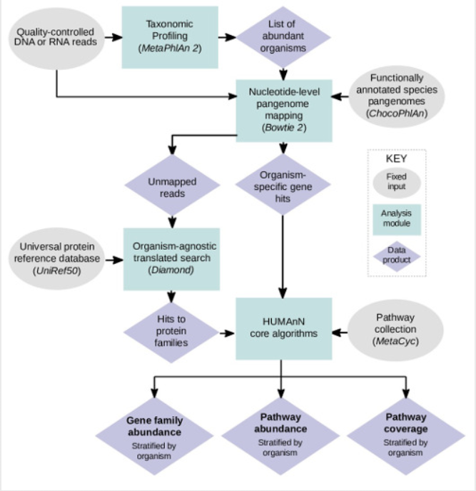
HUMAnN2 Workflow
Has an option to provide a custom pathways database
Franzosa EA*, McIver LJ*, Rahnavard G, Thompson LR, Schirmer M, Weingart G, Schwarzberg Lipson K, Knight R, Caporaso JG, Segata N, Huttenhower C. Species-level functional profiling of metagenomes and metatranscriptomes. Nat Methods 15: 962-968 (2018).

Slide 30
HUMAnN2 Setup
Requirements
•MetaPhlAn2 (version <= 2.6.0)
•Bowtie2 (version >= 2.1)
•Diamond (0.9.0 > version >= 0.8.22)
•MinPath
•Python (version >= 2.7)
Databases
humann2_databases --download chocophlan full $INSTALL_LOCATION
humann2_databases --download uniref uniref90_diamond $INSTALL_LOCATION
Franzosa EA*, McIver LJ*, Rahnavard G, Thompson LR, Schirmer M, Weingart G, Schwarzberg Lipson K, Knight R, Caporaso JG, Segata N, Huttenhower C. Species-level functional profiling of metagenomes and metatranscriptomes. Nat Methods 15: 962-968 (2018).

Slide 31
$ humann2_test
test_add_length_annotation (basic_tests_utilities.TestHumann2UtilitiesFunctions) ... ok
test_add_length_annotation_spaces (basic_tests_utilities.TestHumann2UtilitiesFunctions) ... ok
test_break_up_fasta_file (basic_tests_utilities.TestHumann2UtilitiesFunctions) ... ok
test_count_reads_fasta (basic_tests_utilities.TestHumann2UtilitiesFunctions) ... ok
...
Franzosa EA*, McIver LJ*, Rahnavard G, Thompson LR, Schirmer M, Weingart G, Schwarzberg Lipson K, Knight R, Caporaso JG, Segata N, Huttenhower C. Species-level functional profiling of metagenomes and metatranscriptomes. Nat Methods 15: 962-968 (2018).

Slide 32
HUMAnN2 input formats
•Quality controlled shotgun metagenomes or metatranscriptomes (fastq, fastq.gz, fasta, or fasta.gz)
•Mapping results (sam, bam or blastm8)
•Gene abundance tables (tsv or biom)
Franzosa EA*, McIver LJ*, Rahnavard G, Thompson LR, Schirmer M, Weingart G, Schwarzberg Lipson K, Knight R, Caporaso JG, Segata N, Huttenhower C. Species-level functional profiling of metagenomes and metatranscriptomes. Nat Methods 15: 962-968 (2018).

Slide 33
HUMAnN2 Run
cd /path/to/file/biobakery-metaphlan2-5bd7cd0e4854/utils/
mkdir /proj/snic2019-35-23/humann2_filtered_wrkshpF
humann2 --input /path/to/file/filtered_wrkshpF.fastq --output /path/to/file/humann2_filtered_wrkshpF --metaphlan /path/to/file/biobakery-metaphlan2-5bd7cd0e4854/ --nucleotide-database /path/to/file/chocoplan --protein-database /path/to/file/uniref --remove-temp-output
Franzosa EA*, McIver LJ*, Rahnavard G, Thompson LR, Schirmer M, Weingart G, Schwarzberg Lipson K, Knight R, Caporaso JG, Segata N, Huttenhower C. Species-level functional profiling of metagenomes and metatranscriptomes. Nat Methods 15: 962-968 (2018).

Slide 34
HUMAnN2 Output
1. Gene families file
Gene families are groups of evolutionarily-related protein-coding sequences that often perform similar functions.
The abundance of each gene family in the community
Stratified to show the contributions from known and unknown species
Reported in RPK (reads per kilobase) units to normalize for gene length
RPK units reflect relative gene copy number in the community
"UNMAPPED" value is the total number of reads which remain unmapped after both alignment steps (nucleotide and translated search)
Since other gene features in the table are quantified in RPK units, "UNMAPPED" can be interpreted as a single unknown gene of length 1 kilobase recruiting all reads that failed to map to known sequences.
The UniRef50_unknown values represent the total abundance of reads which map to ChocoPhlAn nucleotide sequences which do not have a UniRef50 annotation.
Franzosa EA*, McIver LJ*, Rahnavard G, Thompson LR, Schirmer M, Weingart G, Schwarzberg Lipson K, Knight R, Caporaso JG, Segata N, Huttenhower C. Species-level functional profiling of metagenomes and metatranscriptomes. Nat Methods 15: 962-968 (2018).

Slide 35
HUMAnN2 Output
2. Pathway abundance file
The abundance of each pathway in the community as a function of the abundances of the pathway's component reactions
Each reaction's abundance computed as the sum over abundances of genes catalyzing the reaction
Pathway abundance is computed once at the community level and again for each species (plus the "unclassified" stratum) using community- and species-level gene abundances along with the structure of the pathway.
Pathway abundance is proportional to the number of complete "copies" of the pathway in the community.
Franzosa EA*, McIver LJ*, Rahnavard G, Thompson LR, Schirmer M, Weingart G, Schwarzberg Lipson K, Knight R, Caporaso JG, Segata N, Huttenhower C. Species-level functional profiling of metagenomes and metatranscriptomes. Nat Methods 15: 962-968 (2018).

Slide 36
HUMAnN2 Output
2. Pathway abundance file (cont.)
To account for non-linearity in the conversion of gene copy number to pathway copy number, we define a "compression constant" (k) equal to the total pathway abundance divided by the total abundance of genes that contributed to pathways.
The "UNMAPPED" value reported in the pathway abundance table is equal to the total number of unmapped reads scaled by k (making it more comparable with pathway abundance values).
Similarly, we define an "UNINTEGRATED" abundance for 1) the community, 2) each identified species, and 3) the "unclassified" stratum equal to the total abundance of genes in that level that did not contribute to pathways (scaled by k).
"UNINTEGRATED" does not appear for stratifications with no detected pathways.
Franzosa EA*, McIver LJ*, Rahnavard G, Thompson LR, Schirmer M, Weingart G, Schwarzberg Lipson K, Knight R, Caporaso JG, Segata N, Huttenhower C. Species-level functional profiling of metagenomes and metatranscriptomes. Nat Methods 15: 962-968 (2018).

Slide 37
HUMAnN2 Output
3. Pathway coverage file
An alternative description of the presence (1) and absence (0) of pathways in a community, independent of their quantitative abundance
A confidence score to each reaction detected in the community
A pathway with coverage = 1 is considered to be confidently detected (independent of its abundance), as this implies that all of its member reactions were also confidently detected.
A pathway with coverage = 0 is considered to less confidently detected (independent of its abundance), as this implies that some of its member reactions were not confidently detected.
Franzosa EA*, McIver LJ*, Rahnavard G, Thompson LR, Schirmer M, Weingart G, Schwarzberg Lipson K, Knight R, Caporaso JG, Segata N, Huttenhower C. Species-level functional profiling of metagenomes and metatranscriptomes. Nat Methods 15: 962-968 (2018).

Slide 38
HUMAnN2 Output
Normalize the abundance output files
Copies per million or relative abundance
Use the HUMAnN2 tool renorm table, to compute the normalized abundances
for $SAMPLE_genefamilies.tsv in $OUTPUT_DIR
$ humann2_renorm_table --input $SAMPLE_genefamilies.tsv --output $SAMPLE_genefamilies_relab.tsv --units relab
Franzosa EA*, McIver LJ*, Rahnavard G, Thompson LR, Schirmer M, Weingart G, Schwarzberg Lipson K, Knight R, Caporaso JG, Segata N, Huttenhower C. Species-level functional profiling of metagenomes and metatranscriptomes. Nat Methods 15: 962-968 (2018).

Slide 39
HUMAnN2 Output
Join the output files (gene families, coverage, and abundance) from the HUMAnN2 runs from all samples into three files
$ humann2_join_tables --input $OUTPUT_DIR --output humann2_genefamilies.tsv --file_name genefamilies_relab
$ humann2_join_tables --input $OUTPUT_DIR --output humann2_pathcoverage.tsv --file_name pathcoverage
$ humann2_join_tables --input $OUTPUT_DIR --output humann2_pathabundance.tsv --file_name pathabundance_relab
For each command, replace $OUTPUT_DIR with the full path to the folder containing the HUMAnN2 output files.
The resulting files from these commands are named humann2_genefamilies.tsv, humann2_pathabundance.tsv, and humann2_pathcoverage.tsv.
Franzosa EA*, McIver LJ*, Rahnavard G, Thompson LR, Schirmer M, Weingart G, Schwarzberg Lipson K, Knight R, Caporaso JG, Segata N, Huttenhower C. Species-level functional profiling of metagenomes and metatranscriptomes. Nat Methods 15: 962-968 (2018).

Slide 40
Resistome profiling

Slide 41
Resistome profiling
Profiling the antibiotic resistance genes in a community
ShortBRED: Short, Better Representative Extract Dataset
Kaminski J, Gibson MK, Franzosa EA, Segata N, Dantas G, Huttenhower C.High-specificity targeted functional profiling in microbial communities with ShortBRED.PLoS Comput Biol. 2015 Dec 18;11(12):e1004557.

Slide 42
ShortBRED Features
Take a set of protein sequences
Reduce them to a set of unique identifying strings ("markers)
Search for these markers in metagenomic data
Determine the presence and abundance of the protein families of interest
ShortBRED Identify
ShortBRED-Quantify
Kaminski J, Gibson MK, Franzosa EA, Segata N, Dantas G, Huttenhower C.High-specificity targeted functional profiling in microbial communities with ShortBRED.PLoS Comput Biol. 2015 Dec 18;11(12):e1004557.

Slide 43
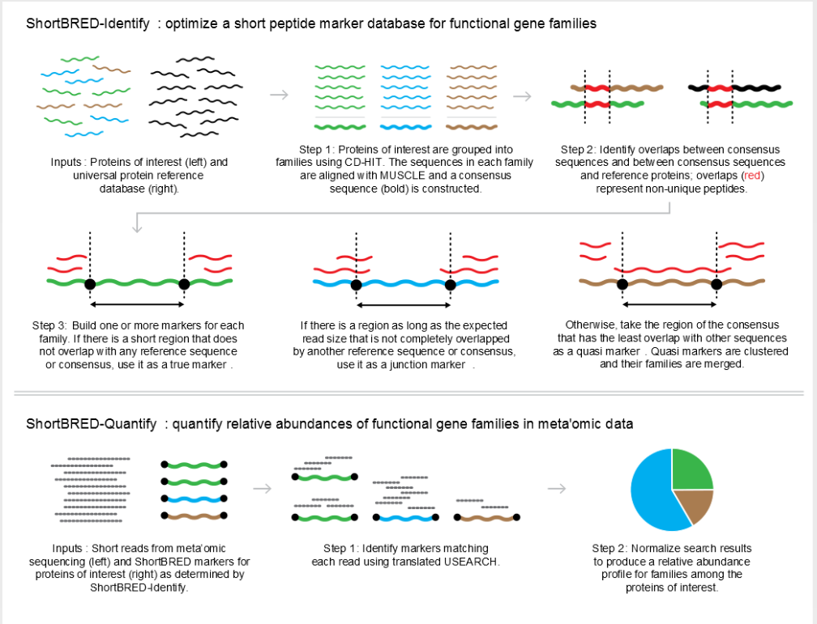
ShortBRED Workflow
Kaminski J, Gibson MK, Franzosa EA, Segata N, Dantas G, Huttenhower C.High-specificity targeted functional profiling in microbial communities with ShortBRED.PLoS Comput Biol. 2015 Dec 18;11(12):e1004557.

Slide 44
ShortBRED Input Formats
Sample markers file (CARD_2017_markers)
Short nucleotide reads (wgs.fna)
https:// bitbucket.org/biobakery/shortbred/downloads/ShortBRED_ CARD_2017_markers.faa.gz
Kaminski J, Gibson MK, Franzosa EA, Segata N, Dantas G, Huttenhower C.High-specificity targeted functional profiling in microbial communities with ShortBRED.PLoS Comput Biol. 2015 Dec 18;11(12):e1004557.

Slide 45
ShortBRED Run
cd /path/to/file/biobakery-shortbred-918294a74d70/
python ./shortbred_quantify.py --markers /path/to/file/biobakery-shortbred-918294a74d70/sample_markers/ShortBRED_CARD_2017_markers.faa --wgs /path/to/file/filtered_wrkshpF.fasta --results results_shortbred_filtered_wrkshpF.tsv --tmp shortbred_filtered_wrkshpF_quantify
Kaminski J, Gibson MK, Franzosa EA, Segata N, Dantas G, Huttenhower C.High-specificity targeted functional profiling in microbial communities with ShortBRED.PLoS Comput Biol. 2015 Dec 18;11(12):e1004557.

